Slide 1
307: Engaging Latino Families /
Entendiendo La Familia Latina y Su Cultura
Notes:
I edited the titled.

Slide 2
Section para Tarjeta de Presentacion:
En el Centro escriba: Nombre
En la esquina superior izquierda escriba: Agencia/Condado
En la esquina superior derecha escriba: Departamenta/Posición en su trabajo
En la esquina inferior izquierda escriba: Tiempo de trabajo en esta posición
En la esquina inferior derecha escriba: Población latina a la que más se sirve en su agencia?
Agencia/Condado | Nombre | Departmenta/Posición en su trabajo
Tiempo trabajando en esta posición |  | Población latina a la que más se sirve en su agencia?
2
Notes:
Edited.

Slide 3
Learning Objectives
Participants will be able to:
Describe general characteristics of various Latino cultures
Define differences between traditional family roles within Latino cultures and Non-Latino culture
Be aware of the history of various countries of origin, which impact their cultural values
Understand the history and outcomes of Latino immigration to America
Explain the discipline and parenting techniques prevalent in various Latino cultures
Identify opportunities to implement new knowledge into culturally appropriate interventions with child welfare clients
4

Slide 4
Reflection
Please use this time to reflect on the following:
Initial impressions
Personal experiences
Perception of how Latino families and individuals act the same or differently than you
“Face what you think you believe and you will be surprised.”
-- William Hale White
“The real voyage of discovery consists not in seeking new landscapes, but in having new eyes.”
-- Marcel Proust

Slide 6
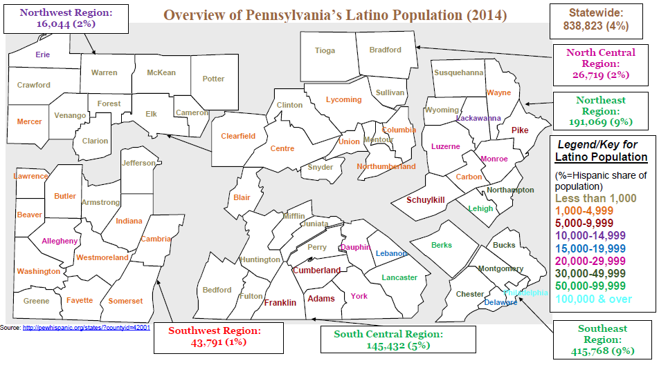
4

Slide 7
History of Migration
(http://mapsof.net/south-america/south-america-political-map)
Notes:
Goal: Reference to Resources Secction B. The map aids to understand what countries are more likely to have their populations to come to the USA by geographic proximity as well as social stress of USA international policies in the region. The Monroe Doctrine theory made of the Caribbean, Mexico, Central American and South America the backyard of United States. “Not in my backyard” is the phrase, even in the current administration, that has justified political and military intervention with increase of migration as a result.
http://mapsof.net/south-america/south-america-political-map

Slide 8
Mexico Migration 1845
(http://en.academic.ru/pictures/enwiki/77/Mexican_Cession_in_Mexican_View.PNG)
Notes:
Goal: Understand cultural links with people of Mexican origin. 51% of Mexico became one third of the USA in what historian Howard Zinn has named an “unjust war.” Mexico did not come to USA. USA came to Mexico and took over. Besides, Spanish is the first European language spoken in what is now the USA. The first city of what is now USA was St. Augustine, 1565. In 1513, Ponce De Leon, a Spaniard navigator already navigated by the Lewes, DE, waters. (Sometimes, SW doesn’t know how linked our history is.) Also, Mexico contributed so much funding for the Independence War that Pollack, the accounting person fro the British showed in his book the two collums and the type of flag around them that became th symbol of the US dollar. It came from Spain. I have all this sources. Cannot work on this at this time as I have a presentation tonight.

Slide 9
Naming Conventions
First Names
Latin Americans traditionally have two first names. For example: Antonio Benjamin, Edison Amilcar, Reinaldo Anibal, Rosa Graciela, Greta Yolanda
These names are often associated with religions names, such as Rosario de Jesus (Rosary of Jesus), Maria de los Angeles, Marie de Lourdes, Ana de las Mercedes
Some may have three names, after adding a third name during Catholic confirmation
Last Names
Latin Americans (Mexico, Carribean, Central and South America) are entitled to two last names, with one from each parent
The first last name comes from the father, the second last name comes from the mother
If a child is an orphan or only has one parent a second last name will be created, perhaps by using the mother’s name twice or creating one

Slide 10
Identifying Who’s in the Picture
Who do I talk to? (male vs. female caseworker)
Who lives here?
Is that your husband?
Are you legally married or living together?
Have you always lived here?
Where do you come from? Where were you born?
How can I understand how your family works?
How are decisions made?
Who takes care of the children? Who cooks?
How do you earn money?
What types of bills do you have?
Who pays the bills?
Where does everybody sleep?
For further information on family relationship and other household words, refer to the Audio Dictionary lists in the Resource Manual.

Slide 11
Hidalgo’s Level of Culture
Concrete culture – aspects of culture that are tangible and visible, such as clothing, music and food
Behavioral culture – how we define and organize society, such as social roles, family structure, language and approach to non-verbal communication
Symbolic Culture – abstract view of ourselves, including values and beliefs and customs
(Hidalgo, N. (1993). Multicultural teacher introspection. In T. Perry, & J. Fraser (Eds.), Freedom’s plow: Teaching in the multicultural classroom (99-106). New York: Routledge)

Slide 12
Cultural Continuum
Each country and region can be generally characterized by value and belief systems, however, this is just a starting point. Each family’s values and beliefs are influenced by more than just their cultural group. Other influences may include:
Assimilation (rejecting native culture)
Acculturation or accommodation (choosing aspects of dominant and native cultures)
Transculturation (blending of cultures)
Alienation (rejecting the dominant culture)
Marginalization (rejecting native culture without connecting to another culture)
(Buenaventura https://www.pakeys.org/uploadedcontent/docs/elinpa/ell%20toolkit/cultural%20identity.pdf)

Slide 13
Geography and Culture
The continuum of culture applies to geographical influences as well. Latinos may come from tropical, mountainous, or desert areas. Some are from countries with indigenous populations while others are from areas with more European heritage.
Geography affects language as well. Not all Latinos speak Spanish. Latino languages include Spanish, numerous native languages, and Portuguese.
(http://etc.usf.edu/maps/pages/5900/5973/5973.htm)

Slide 14
Potential Conflict Areas
Discipline
Abuse vs. physical discipline
Overcrowded conditions
Neglect/Poverty issues
School issues
Supervision
Drug & alcohol use
Mental Health Treatment/Services
Medical Treatment/Services
Placement of a child
Comfort object/Cultural surroundings
Adherence to MEPA standards
Clearances for extended family
8

Slide 15
Cultural Components in the Casework Relationship
Remember to include the following approaches:
Determine applicability of traditional values and beliefs to this particular family
Become familiar with social behavior rules for the particular sub-group/family culture and abide by them
Openly acknowledge cultural differences in the early stages of the relationship and establish a mutually agreed upon way to address misunderstandings
Develop an understanding of how the family relates to outside groups and agencies
Communicate interest in the family and be willing to understand things from their perspective
Use interviewing techniques which frequently clarify meaning, use understandable words/phrases, and encourage feedback
Address language differences through use of trained interpreters
(Rycus & Hughes. (1998). Field Guide to Child Welfare: Case Planning and Family-Centered Casework, Volume II. Washington, DC: CWLA Press)
9

Slide 16
The Impact of Culturally Competent Practice
Culturally competent practice:
Enhances overall communication and facilitates family engagement
Allows child welfare professionals to obtain more specific and complete information upon which to form an Assessment
Influences how individuals cope with problems and positively affects help-seeking behaviors
Increases the likelihood that a Family Service Plan will be adhered to by the family or client system
Positively impacts case outcomes
10

